Slide 1
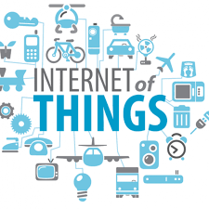
Introduction and evolution of IoT

Slide 2
Contents
Introduction
Internet of Things Definition
Evolution
Characteristics of IoT
Components
Applications of IoT

Slide 3
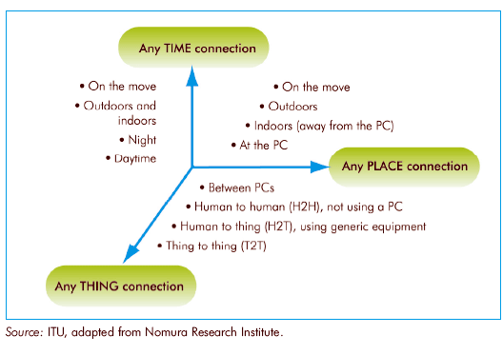
Introduction
Internet of Things (IoT) is a computing concept which provides interconnection between the uniquely identifiable devices.
Three Major Elements:
Object + Intelligence + Internet
From any time, any place connectivity for anyone, we will now have connectivity for anything!

Slide 4
Introduction
https://www.youtube.com/watch?v=QSIPNhOiMoE
https://www.youtube.com/watch?v=uEsKZGOxNKw

Slide 5
Internet of Things Definition
Kevin Ashton, in a presentation of Procter & Gamble in 1999, coined the term “Internet of Things“.
The Internet of Things (IoT) has been defined in recommendation ITU-T Y.2060 (06/2012) as :
“a global infrastructure for the information society, enabling advanced services by interconnecting (physical and virtual) things based on existing and evolving interoperable information and communication technologies.”

Slide 6
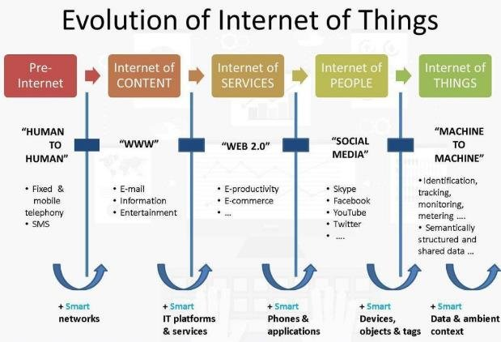
Evolution

Slide 7
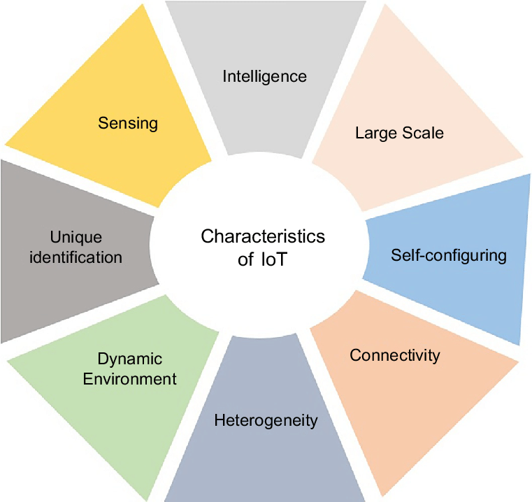
Characteristics

Slide 8
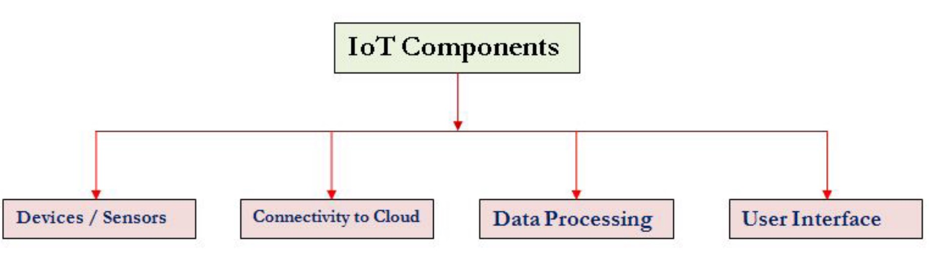
Components

Slide 9
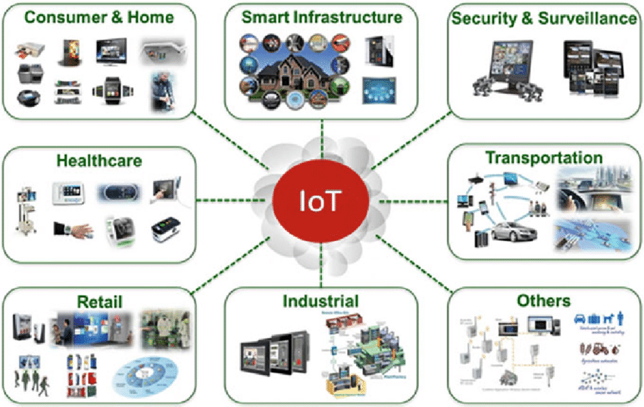
Applications of IoT

